Slide 1
X-section AN-AS
See Cross section locations.kmz & Cross section labels.kmz for location in Google Earth

Slide 2
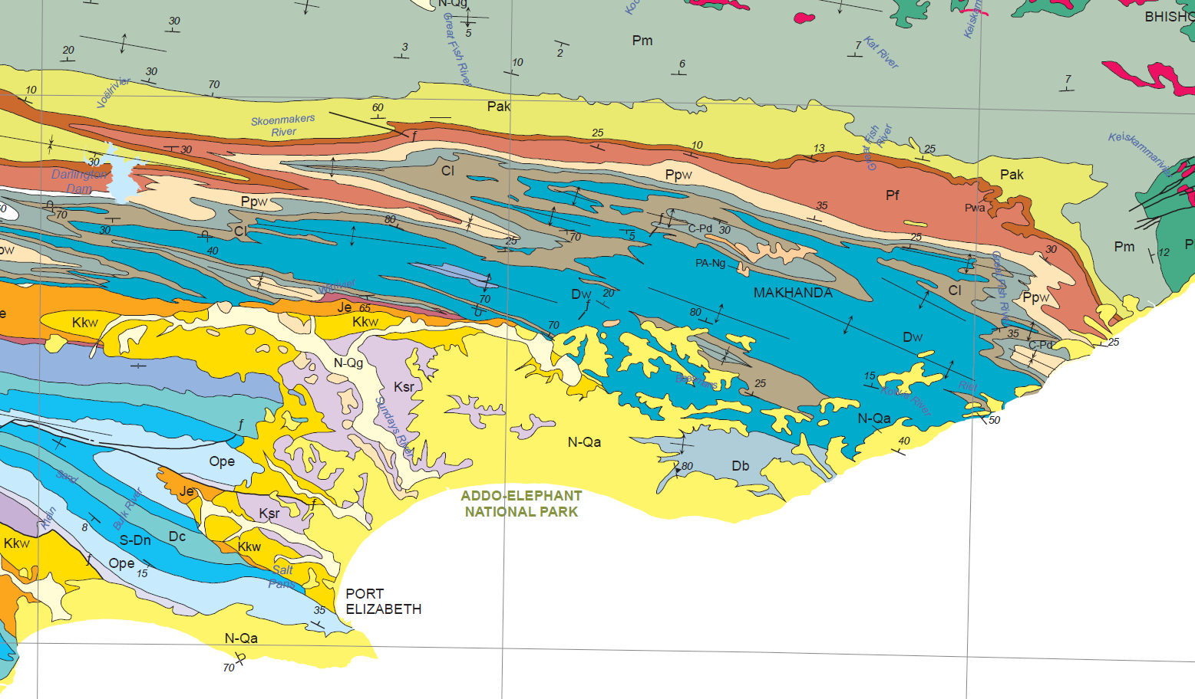
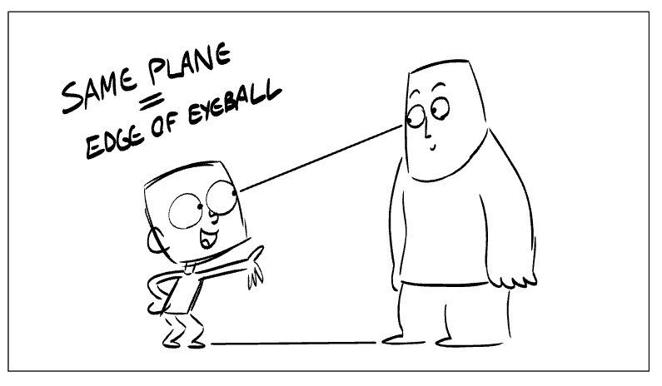
Location of Cross Section on 1:1M (2019 Ed.)
AN
AS

Slide 3
Schematic Cross Section AN – AS
Suurberg volcanics
Beaufort
Je
Kirkwood
Je
Je
Enon
Ecca
Dwyka
Enon
Table Mountain
Witteberg
Table Mountain
Bokkeveld
Gamtoos
Gamtoos
Table Mountain
Gamtoos
AN
AS

